Slide 1
Migration Information Campaign Partner Pack
October 2024

Slide 2
Goal: Provide factual information to people living in Ireland, about migration and about how immigration services work.

Slide 3
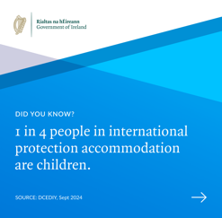
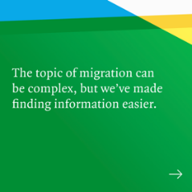
Migration in Ireland 2024
This is a cross-Government public information campaign to make it easier to find factual information about migration and how immigration services work.
This pack contains:
Key information
Social media assets
Resource templates
for you to use across your own channels and platforms to participate in the campaign.

Slide 4
About this campaign
The Government of Ireland has begun a new public information campaign to help people find out more about migration and to better understand how our immigration system works.
Immigration is complex, but talking about it shouldn’t be, and it can be difficult to know where to go to find reliable information.
This mainly social media campaign shares clear facts, and encourages people to visit Gov.ie/migration to learn more. On the freshly updated website, people will find simple, reliable and factual information about migration and how our immigration systems work.
The purpose is to make it easier for people to find and check the facts, and to share information that people can use in the conversations that we know are happening about migration.
The site gives an overview of the rules and processes that must be followed by people who move to Ireland. It shows how Ireland’s is benefitting from people moving here to live, work and study, especially in areas like our healthcare and construction industry.
People can learn how Ireland provides shelter to people seeking asylum and fleeing war and persecution, and the whole-of-Government approach taken to help them integrate into local communities.
The migration and integration topics covered throughout the campaign have been selected based on feedback from local communities and representatives, research, and consultation with key stakeholders and government Departments.

Slide 5
Migration in Ireland 2024
Key messages
Migration is complex – but talking about it and finding information shouldn’t be
We’re making it easier to find the facts about migration in Ireland
You can get the ins and outs of migration in Ireland at gov.ie/migration – an up-to-date, trusted source of factual information
Did you know
1 in 5 workers in Ireland is a citizen of another country. They are essential to our healthcare, construction and many other sectors.
Most people moving to Ireland come to work or study, or to join family
1 in 4 people in international protection accommodation are children and we provide accommodation in every county in Ireland.
Local communities are helping new arrivals in Ireland to settle in and there are a range of supports to help.
Most social media platforms allow you to report false or inaccurate content about immigration.

Slide 6
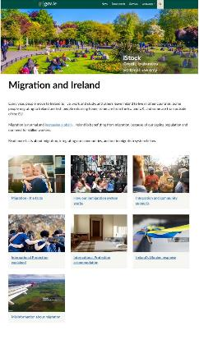
Gov.ie/migration
The Gov.ie/migration hub has been redesigned and upgraded
New content aims to respond to key questions people have
The focus is on factual, referenced information, in plain language

Slide 7
Paid Promotion
The campaign messages and website will be promoted on
Social media
Youtube
Google Search
Digital display ads
All our adverts aim to share information and let people know where to get trustworthy information on migration.

Slide 8
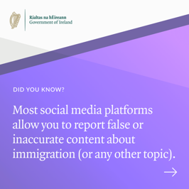
Website and Campaign Topics
The numbers
Population, migration, context
The process
How immigration works, our fair, rules-based system for immigration: work, study and international protection
Accommodation for international protection
Why we provide it, where and how
Our common ground
Ireland’s changing population, how we support integration, how to get involved, how to get supports in your community
The misinformation
How to fact-check what you see or hear and report false information

Slide 9
Campaign Resources
1. Social media assets and channels
2. Social media templates
3. Awareness poster for print
4. Contact information

Slide 10
How to get involved
We greatly appreciate your help with the reach and impact of this campaign.
This pack includes resources and media that you can use to support the campaign.
You can get involved by sharing the social posts from the @merrionstreet social media channels, or by posting directly on your own accounts using the images, videos or messages provided.
If you’d like to download a campaign poster, contact partners@equality.gov.ie and
we’ll provide a print ready image for you.

Slide 11
Social media assets and channels
To repost or share content, find our posts on the Government of Ireland’s social media channels:
Instagram: www.instagram.com/merrionstreet
Facebook: www.facebook.com/merrionstreet
X (formerly Twitter): https://x.com/merrionstreet
LinkedIn: www.linkedin.com/company/governmentofireland/

Slide 12
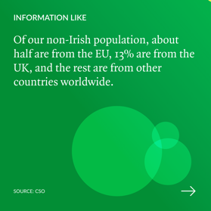
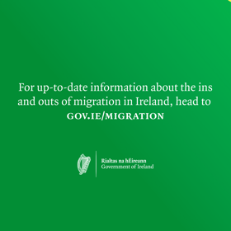
Post 1: 1 in 5 workers
Instructions
These images make up a 4 post carousel. When posting, please follow the order presented on the right. A video version of this post is available here
Video 1: 1 in 5 workers
Sample re-post copy
Want to know more about migration in Ireland? You can find everything there is to know at gov.ie/migration
Are you curious about how migration works in Ireland? You’ll find up-to-date stats and information at gov.ie/migration
Get to know the ins and outs of migration in Ireland at gov.ie/migration
Image 1
Image 2
Image 3
Image 4

Slide 13
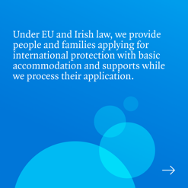
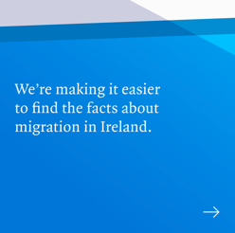
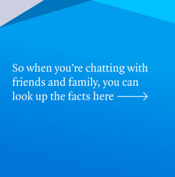
Post 2: 1 in 4 in IPA are children
Instructions
These images make up a 5 post carousel. When posting, please follow the order presented on the right.
A video version of this post is here Video 2: 1 in 4 are children
Sample re-post copy
Want to know more about migration in Ireland? You can find everything there is to know at gov.ie/migration
Are you curious about how migration works in Ireland? You’ll find up-to-date stats and information at gov.ie/migration
Get to know the ins and outs of migration in Ireland at gov.ie/migration
Image 1
Image 2
Image 3
Image 4
Image 5

Slide 14
Post 3: Misinformation
Instructions
These images make up a 3 post carousel. When posting, please follow the order presented on the right. A video version of this post is available here Video 3: Misinformation
Sample re-post copy
Want to know more about migration in Ireland? You can find everything there is to know at gov.ie/migration
Are you curious about how migration works in Ireland? You’ll find up-to-date stats and information at gov.ie/migration
Get to know the ins and outs of migration in Ireland at gov.ie/migration
Image 1
Image 2
Image 3

Slide 15
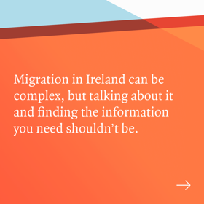
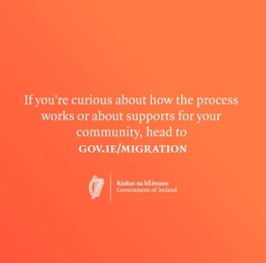
Post 4: Local communities
Instructions
These images make up a 4 post carousel. When posting, please follow the order presented on the right. A video version of this post is available here Video 4: Local communities
Sample re-post copy
Did you know that in every county across Ireland, local communities are helping new arrivals to get settled and take part in community life.
Did you know that there are supports are available to help communities to offer an Irish welcome. Find out more at gov.ie/migration
Did you know that every local authority has an Integration Team whose role is to support new arrivals into communities?
Image 1
Image 2
Image 3
Image 4

Slide 16
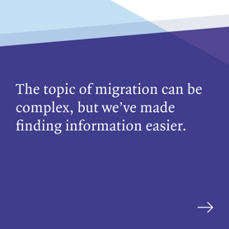
Post 5: International Protection Accommodation
Instructions
These images make up a 4 post carousel. When posting, please follow the order presented on the right. A video version of this post is available here Video 5: Every county
Sample re-post copy
Want to know more about migration in Ireland? You can find everything there is to know at gov.ie/migration
Communities and community groups across Ireland are making huge efforts to welcome international protection applicants to Ireland.
Did you know that there’s funding available to help community-based organisations support the integration of International Protection applicants at local and national level?
Image 1
Image 2
Image 3
Image 4

Slide 17
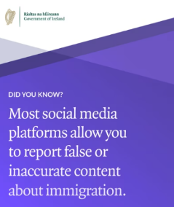
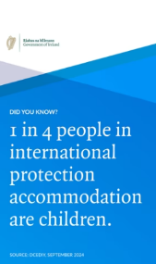
Social videos
Please find links to the video assets to share to your social story and feed
16:9 Youtube Video 20 seconds
Whole campaign message:
https://youtu.be/OAizWo5dE_M
9:16 – Social Stories
Video 1: 1 in 5 workers
Video 2: 1 in 4 are children
Video 3: Misinformation
Video 4: Local communities
Video 5: Every county
4:5 – Social Feed
Video 1: 1 in 5 workers
Video 2: 1 in 4 are children
Video 3: Misinformation
Video 4: Local communities
Video 5: Every county

Slide 18
Gov.ie/migration poster
Artwork for this poster is available on request. Posters will be printable A4, A3, A2, A1, A0.
Contact us if you’d like to discuss adapting this to include your own logo.
For further information, please use the contact information on the next slide.

Slide 19
Thank you for taking part in this campaign. For campaign information or resource queries Email: partners@equality.gov.ie

